Slide 1

Facial Recognition using Convolution Neural Network
Batch No: B-01 Project Guide:
M. Sai Rahul (164G1A0589) Dr. T. Hitendra Sarma Ph.D.
Syam Kakarla (164G1A05B0) ` Professor
G. Priyaranjan Reddy (164G1A0571)
C. Sai Charan Singh (164G1A0584)
Srinivasa Ramanujan Institute of Technology
Department of Computer Science & Engineering

Slide 2
Abstract
Facial recognition is one of the popular biometric process which is widely used in surveillance, security, criminal identification, etc.
Deep learning is a subset of machine learning which uses artificial neural networks inspired by the human brain to solve supervised learning (Classification) problems

Slide 3
Contd..
Convolution Neural Networks is one of the neural network architectures, widely used in face recognition problems.
This project proposes a Convolutional Neural Networks (CNN) based facial recognition system

Slide 4
Contd..
This proposed facial recognition system includes :
Building the new face dataset
Data Preparation
Data Analysis
Building the CNN model
Training
Evaluation
Hyper Parameter Tuning
Prediction

Slide 5
Hardware and Software Requirements
Hardware :
CPU: 1xsingle core hyper threaded
RAM: .~12.6 GB Available
Disk: ~320 GB Available
GPU: 1xTesla K80
Software :
Python3
Jupyter Notebook
Scikit Learn
TensorFlow

Slide 6
Existing System
There are several classification models used for face recognition like:
Eigen Face Recognition
Fischer Face Recognition
Local Binary Pattern Histogram ( LBPH )
Some pre-processing techniques includes:
PCA
LDA

Slide 7
Proposed System
The proposed system is based on convolutional neural networks which performs feature extraction automatically
This project aims to develop an end-to-end process to build a custom facial recognition system using convolutional neural network.

Slide 8
Problem Definition
To develop a real time facial recognition system the existing architectures may or may not be handy with real time data.
In order to deal with such real time data and the projects aims to build a CNN model with high accuracy

Slide 9

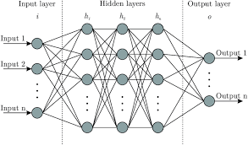
Problem Definition
Fully Connected Neural Network:
Feature Extraction
…
Vector

Slide 10
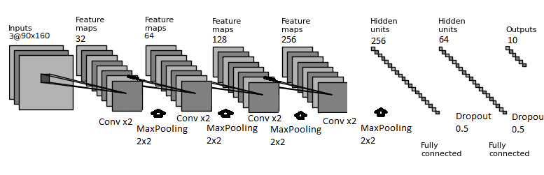
Problem Definition
Convolutional Neural Network:

Slide 11
Planning
1 : Data Collection 2 : Data Cleaning and Exploratory Data Analysis
3 : Model building, training and hyperparameter tuning
4 : Developing Web Application
5 : Documentation and Publication

Slide 12
Literature Survey
[1] Face Recognition Based on Convolutional Neural Network
A modified CNN architecture by adding two normalization operations to two of the layers
The normalization operation used is Batch Normalization
The CNN architecture uses Softmax to classify the faces
In the experimental part Georgia Tech Database is used
An accuracy of about 98.8 is obtained.
Coşkun, Musab, et al. "Face recognition based on convolutional neural network." 2017 International Conference on Modern Electrical and Energy Systems (MEES). IEEE, 2017.

Slide 13
Literature Survey
[2] Illumination Invariant Face Recognition using Convolutional Neural Networks
The problem of face recognition under non-uniform illumination using deep convolutional neural networks (CNN) is addressed
The symmetry of facial information is exploited to improve the performance of the system by considering the horizontal reflections of the facial images
Experiments conducted on Yale facial image dataset demonstrate the efficiency of the proposed approach
Fuzzy fischer approach was used in this problem
Near infrared (NIR) has the potential to overcome the problems associated with visible and thermal IR face recognition which is more robust against illumination variations and face detection

Slide 14
Literature Survey
Ramaiah, N. Pattabhi, Earnest Paul Ijjina, and C. Krishna Mohan. "Illumination invariant face recognition using convolutional neural networks." 2015 IEEE International Conference on Signal Processing, Informatics, Communication and Energy Systems (SPICES). IEEE, 2015.

Slide 15
Literature Survey
[3] A Convolutional Neural Network based on TensorFlow for Face Recognition
A Convolutional Neural Network (CNN) based on TensorFlow, an open source deep learning framework, is proposed for face recognition
Experimental results show that the proposed method has better recognition accuracy and higher robustness in complex environment
They have used Adaboost algorithm
Yuan, Liping, et al. "A convolutional neural network based on TensorFlow for face recognition." 2017 IEEE 2nd Advanced Information Technology, Electronic and Automation Control Conference (IAEAC). IEEE, 2017.

Slide 16
Literature Survey
[4] When Face Recognition Meets with Deep Learning: an Evaluation of Convolutional Neural Networks for Face Recognition
It uses LFW database (Labelled Faces in the Wild)
It also gives a major comparison of 3 published CNNs like DeepFace, DeepID, WebFace.
Quantitatively compares the architectures of CNNs and evaluates the effect of different implementation choices.
Hu, Guosheng, et al. "When face recognition meets with deep learning: an evaluation of convolutional neural networks for face recognition." Proceedings of the IEEE international conference on computer vision workshops. 2015.

Slide 17
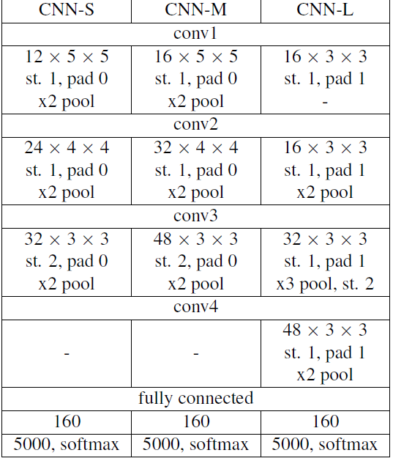
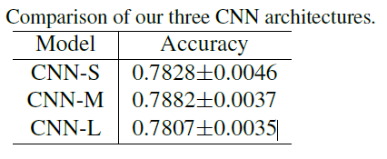
Literature Survey (Cont..)

Slide 18
References
[1] Coşkun, Musab, et al. "Face recognition based on convolutional neural network." 2017 International Conference on Modern Electrical and Energy Systems (MEES). IEEE, 2017.
[2] Ramaiah, N. Pattabhi, Earnest Paul Ijjina, and C. Krishna Mohan. "Illumination invariant face recognition using convolutional neural networks." 2015 IEEE International Conference on Signal Processing, Informatics, Communication and Energy Systems (SPICES). IEEE, 2015.

Slide 19
References
[3] Yuan, Liping, et al. "A convolutional neural network based on TensorFlow for face recognition." 2017 IEEE 2nd Advanced Information Technology, Electronic and Automation Control Conference (IAEAC). IEEE, 2017.
[4] Hu, Guosheng, et al. "When face recognition meets with deep learning: an evaluation of convolutional neural networks for face recognition." Proceedings of the IEEE international conference on computer vision workshops. 2015.

Slide 20
Review - 3
Design and Implementation

Slide 21


Contents
Design
Implementation

Slide 22
Design
CNN Architecture
Web Application Architecture

Slide 23

CNN Architecture

Slide 24

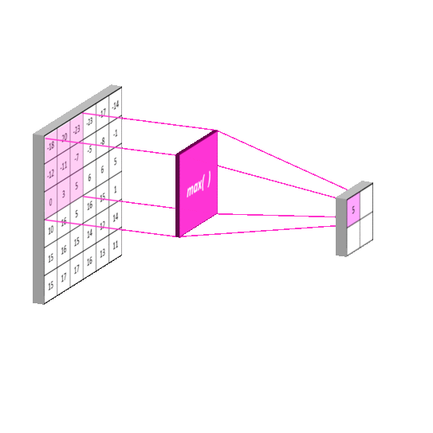
Convolution
Extracts Features from the input given by the previous layers.
Max Pooling
Down sample the input representation by reducing its dimensionality.

Slide 25
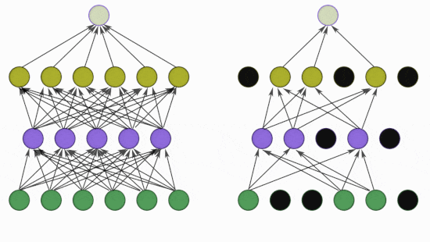
Dropout
Prevents from overfitting.
Learns more robust features.
Normalize the input features given from the previous layer.
Batch Normalization
Improves speed, performance and stability of CNN.
Prevents from vanishing and exploding gradient problems.

Slide 26
CNN Architecture
The architecture has been divided into 4 blocks for easy understanding:
Block – 1
Block – 2
Block – 3
Block – 4

Slide 27
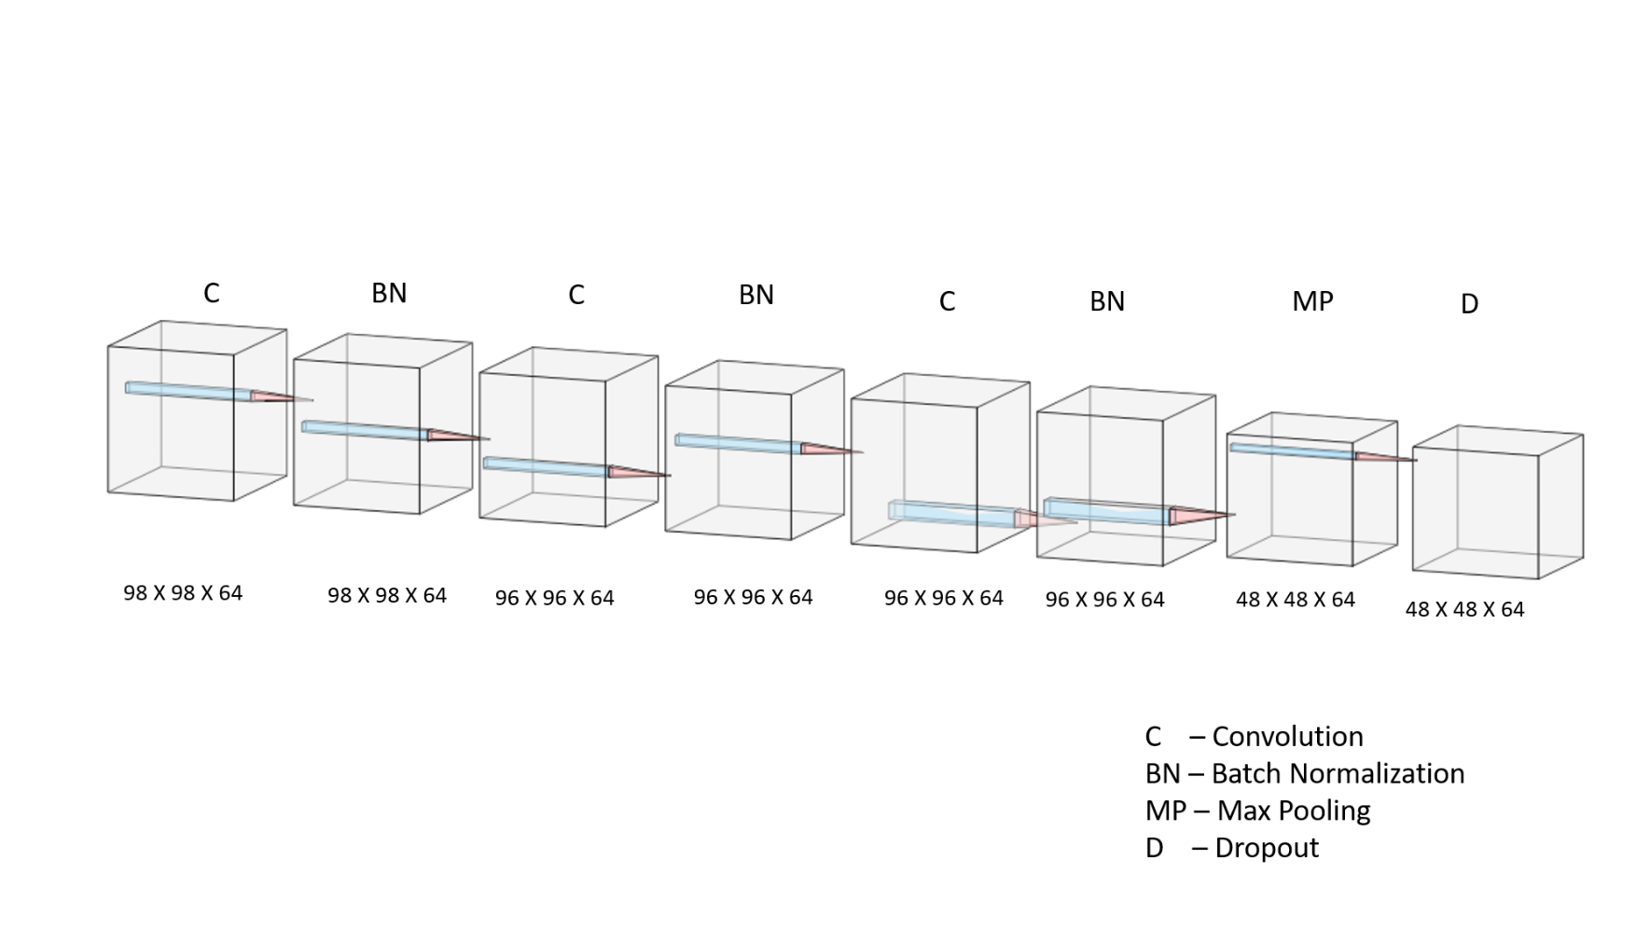
CNN Architecture
Block – 1

Slide 28
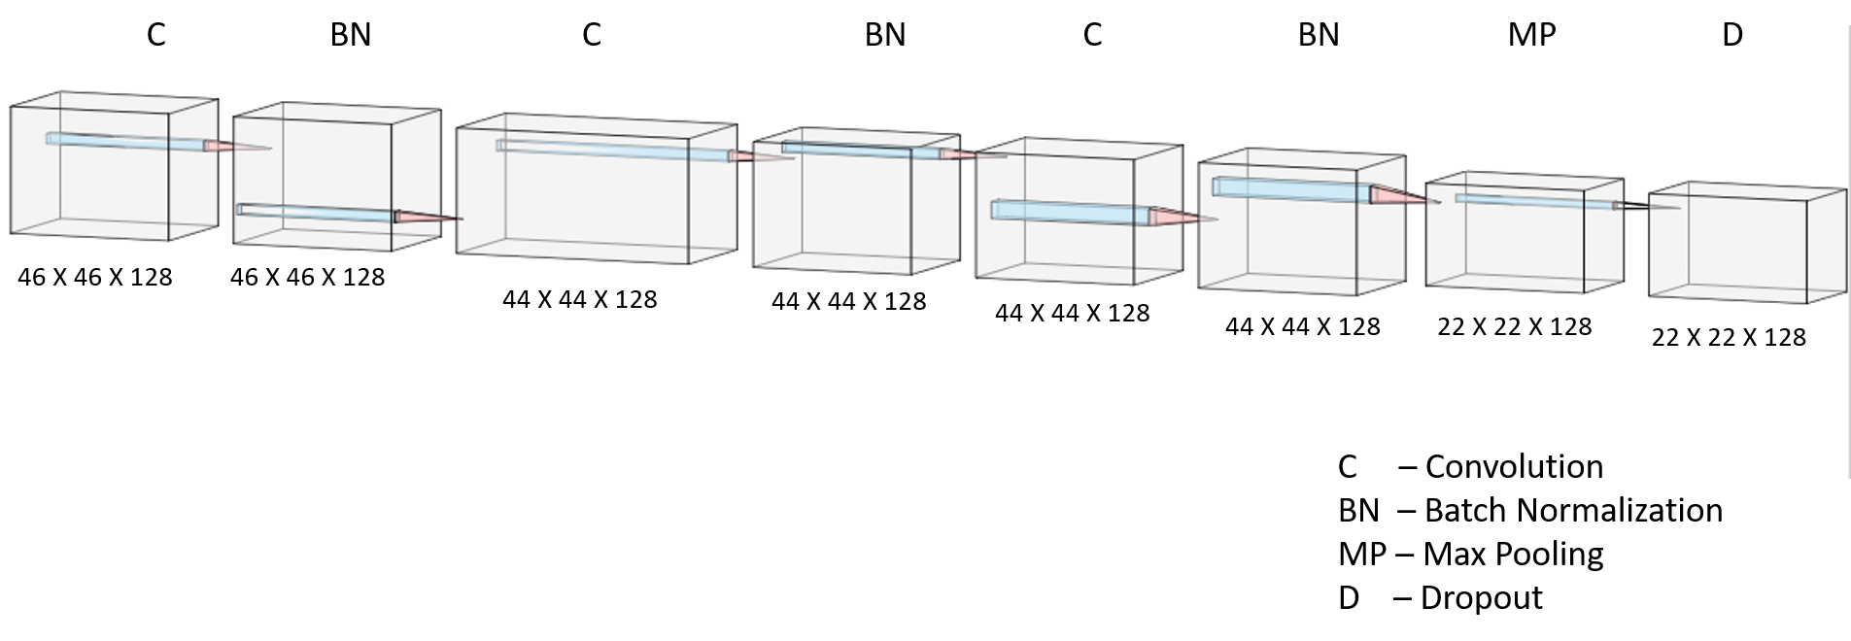
CNN Architecture
Block – 2

Slide 29
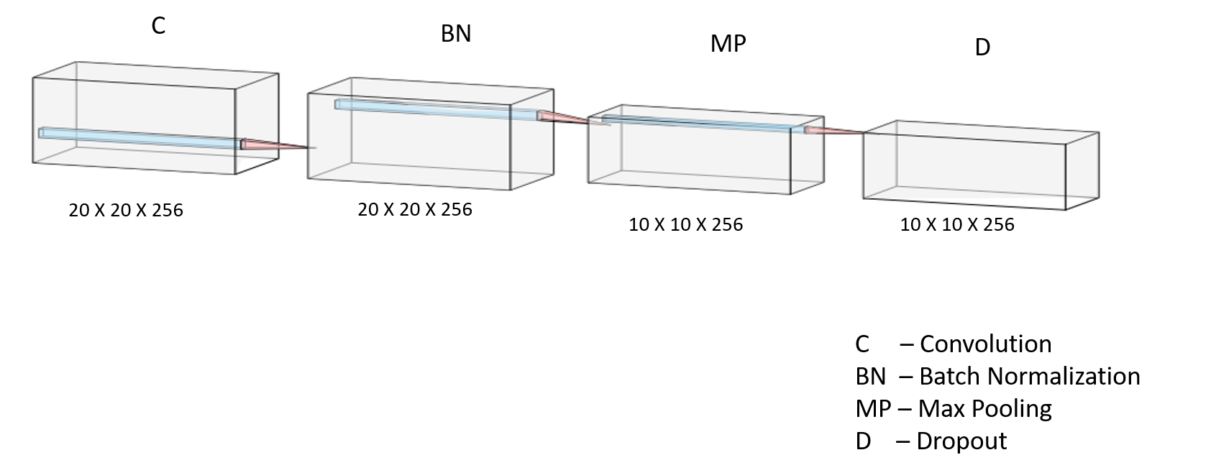
CNN Architecture
Block – 3

Slide 30
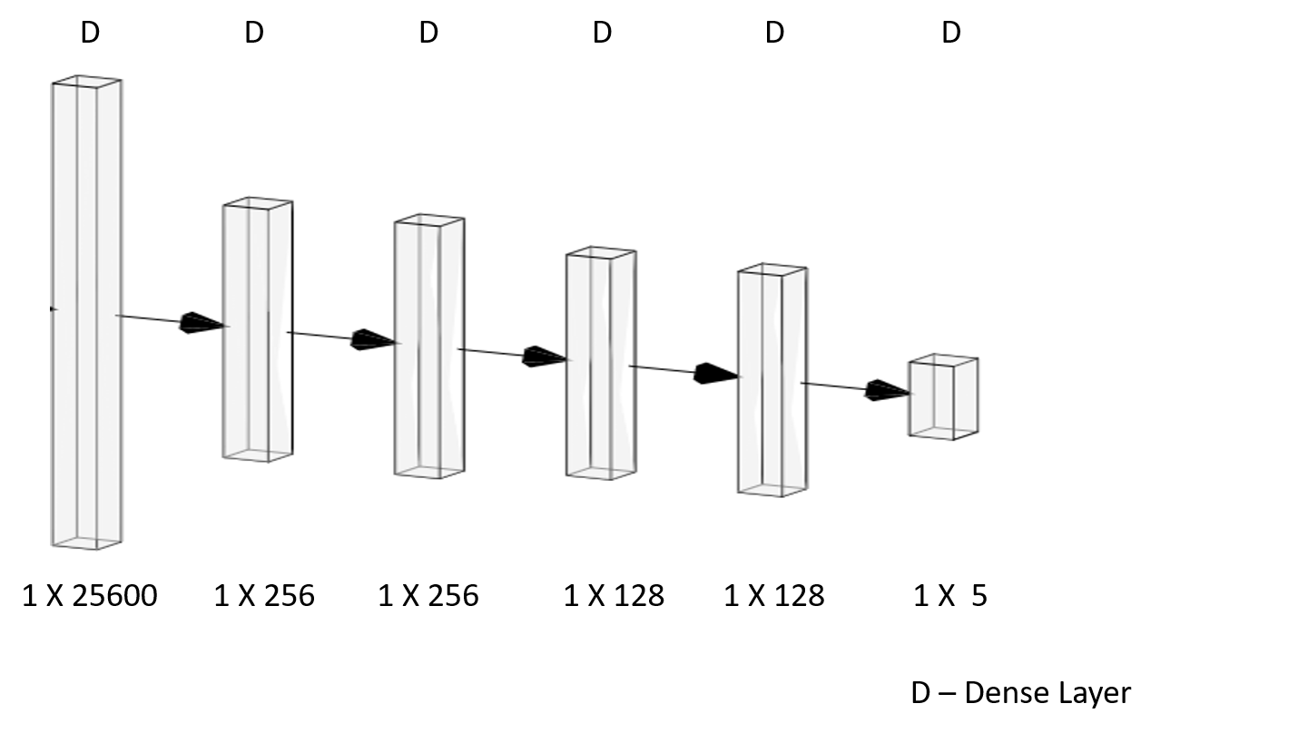
CNN Architecture
Block – 4

Slide 31
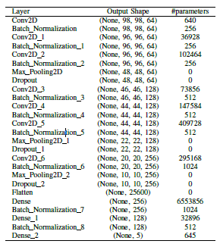
CNN Architecture
Notes:
Explain the architecute layers

Slide 32
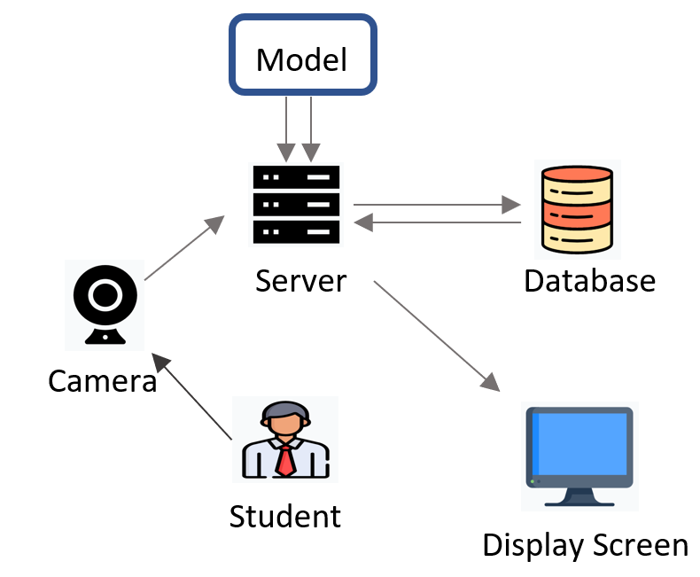
Web Application Architecture

Slide 33
Cont…
The main components of the application are:
1) Front-End Interface (Camera)
2) Server
3) CNN Model
4) Database
5) End Result (Display Screen)

Slide 34
Cont…
Front-End Interface is a web page which takes the video frame as input through the camera using open computer vision (OpenCV) library.
Server is the back-end of the application which maintains the connection with front-end interface, model, database and display screen.

Slide 35
Cont…
The server checks if the attendance is posted previously. If not, the attendance is posted into the database including the timestamp.
The details of the corresponding student will be shown using the display screen, which is web page.

Slide 36
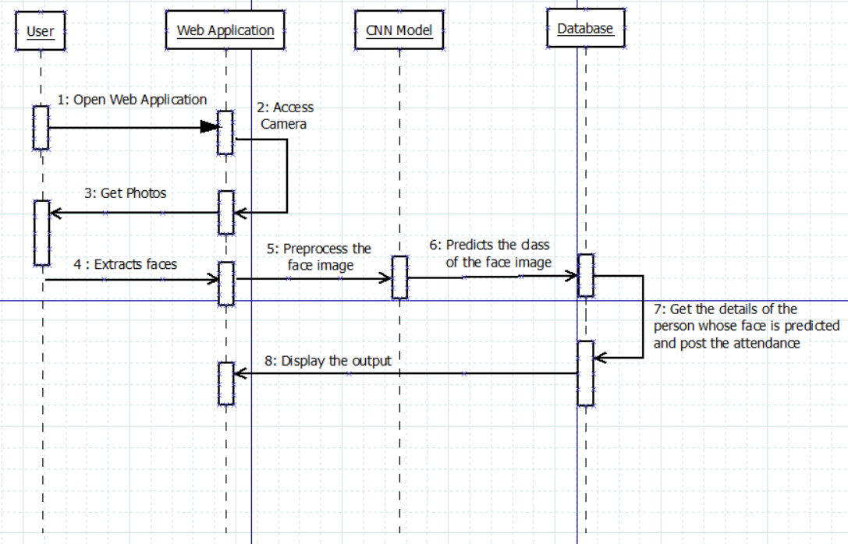
Sequence Diagram

Slide 37
Implementation
Data Collection
CNN Implementation
Web Application
Data Analysis
Data Generation
Data Augmentation
Train and Test Details

Slide 38
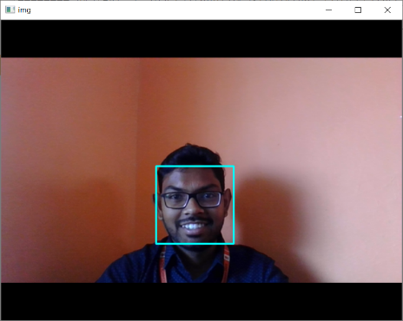




Data Collection
Data Generation
Iterate the process until it reaches desired count of images.

Slide 39
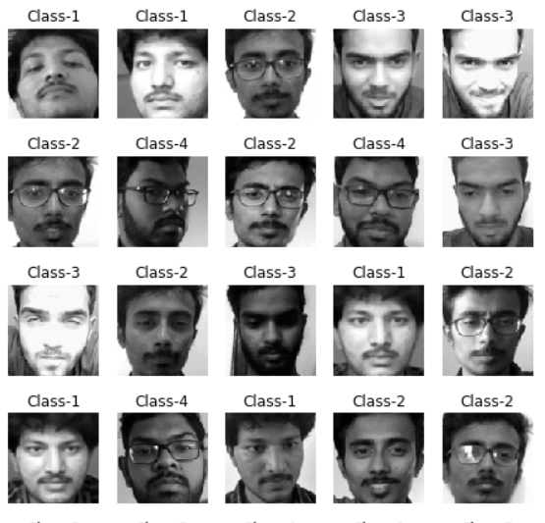
Sample Images

Slide 40
Data Augmentation
Data augmentation technique is used to generate new samples by manipulating the existing data. Synthetic images are being generated randomly, by applying the following operations:
Zoom
Shear
Height Shift
Rotation
Width Shift

Slide 41
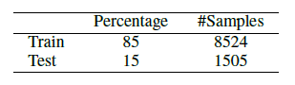
Train and Test Details
The initial samples in dataset are 10,029, which are normalized during training to boost up the processing and the train data is augmented automatically. The actual data is split into train and test data.

Slide 42
Train and Test Details
The entire dataset of 10,029 images are divided into four class labels.
Each class label consists of 2500 images but class label 3 consists of 2529 images.

Slide 43
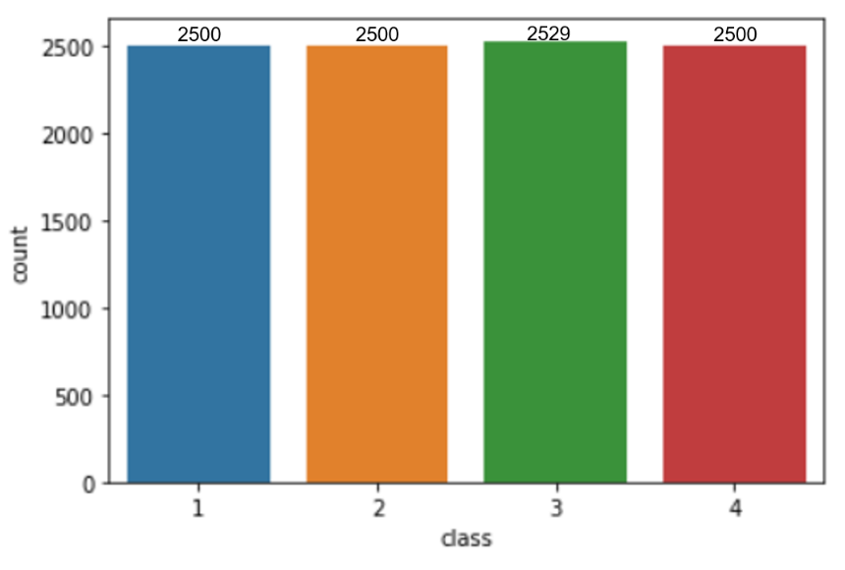
Data Analysis
The Ground Truth of the Dataset
The Count Plot of the Dataset w.r.t the classes

Slide 44
The dataset distribution is visualized as a 3D scatter plot by using Principal Component Analysis (PCA):

Slide 45
CNN Implementation
The proposed CNN consists of 20 layers which includes:
Two Dimensional Convolutional Layer
Batch Normalization Layer
Max pooling Layer
Dense Layer

Slide 46
Cont…
The architecture takes a gray scale image with shape (100,100, 1) and results the class label of the image as prediction.
The total number of parameters of the CNN are 7,658,629 of which 7,656,197 are trainable and 2,432 are non trainable.

Slide 47
Details of Training the CNN Model:
Loss Metric: Categorical Cross Entropy
Optimizer: RMSprop
Learning Rate: 0.001
Batch Size: 256
Epochs: 50
The time taken by the CNN model according to the above parameters is 27min 30 sec.

Slide 48
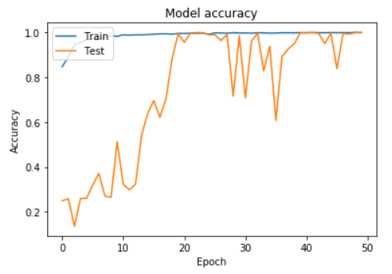
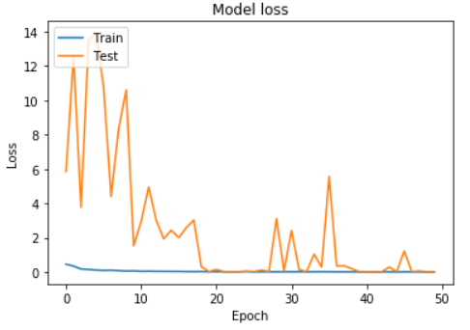
Accuracy & Loss : The below graphs represents the accuracy and loss for the training and testing data.

Slide 49




Web Application
Extracted Face
Grayscale Image
Resized Image
Web interface
Prediction
Trained Model
Output
Update Database

Slide 50
We are pleased to share that we have submitted the paper entitled “Smart Attendance Management System using CNN”
to
IEEE HYDCON Conference

Slide 51
References
[1] Z.-W. Yuan and J. Zhang, “Feature extraction and image retrieval based on alexnet,” in Eighth International Conference on Digital Image Processing (ICDIP 2016), vol. 10033. International Society for Optics and Photonics, 2016, p. 100330E.
[2] R. Fu, D. Wang, D. Li, and Z. Luo, “University classroom attendance based on deep learning,” in 2017 10th International Conference on Intelligent Computation Technology and Automation (ICICTA). IEEE, 2017, pp. 128–131

Slide 52
References
[3] Mikołajczyk and M. Grochowski, “Data augmentation for improving deep learning in image classification problem,” in 2018 international interdisciplinary PhD workshop (IIPhDW). IEEE, 2018, pp. 117–122.
[4] Z. Zhiyao and B. M. Di, “Multiplet selection: a practical study of multifaces recognition for student attendance system,” in Proceedings of the 2nd International Conference on Image and Graphics Processing, 2019, pp. 42–46.

Slide 53
Thank you
Queries
?
Notes:
DOS VIDANYA

